Slide 1
Products Review
Presented by

Slide 2
Products – Capital Lease
Terms up to 72 months (84 for very strong clients but we prefer shorter term with residual)
Capitalized on the client’s balance sheet
Nothing to sign with the dealer
Invoice must be made to: MHCCA or MHCCL
Can sign one lease that includes assets from many suppliers
Purchase option from $1.00 to a maximum of 50% of the equipment cost (subject to credit approval)
No residual risk to MHCCA (please make sure to understand the end of lease provision)
Skips /seasonal payments / IOP available (subject to credit approval)
Not yet offered in USD, but we can pay a USD invoice and convert the lease into CAD which creates additionnal revenues for MHCCA
Fiscal treatment = lease payment is expensed
Accounting treatment = shows as a liability on balance sheet, client expenses depreciation and interest on income statement.

Slide 3
Products – Operating Lease
ACCOUNTING TREATMENT: 4 criterias are required to qualify lease off balance sheet
Term must be less than 75% of useful life of the asset
Present value of rentals equal less than 90% of equipment cost
No bargain price purchase option
No automatic transfer of property at the end of the term
FISCAL TREATMENT Operating Lease vs Capital Lease is the same (rental – expensed)
Since Jan 1, 2019, new IFRS rules make it more difficult to treat leases as « off balance sheet » for larger companies who need to comply with IFRS (International accounting rules). Required to be 12 months or less rental contract.
Our current operating lease contract allows return (provisions 16, 17 and 19 – see next page) but in the event of gain / loss at resale difference will be paid by client / refunded to him
Most of our clients don’t apply new IFRS rules so this doesn’t apply to them
No fiscal benefit to treat on or off balance sheet, real benefit is only presentation of financial statements
OUR LEASE MIGHT QUALIFY with some accountants as « off balance sheet » if structure meets criterias but we should not do any representation about this, clients must always validate with their external accountant.

Slide 4
Products – Operating Lease
We can currently offer some TYPES OF OPERATING LEASES, but our offering is limited:
If we have a repurchase agreement on residual from a solid Vendor (subject to credit approval)
In the Wajax program when leasing Hitachi wheel loaders (true RV to MHCCA which is shared with Wajax)
For good customers on very good assets (ex. Peterbilt, Kenworth trucks), we could consider doing operating lease (FPO or FMV), subject to structured credit approval
So far we have quoted a few transactions but have not win one yet
Some competitors are very aggressive on trucks RV ex. Wells Fargo, BMO, Daimler Truck Financial.

Slide 5
Products – Operating Lease
SOME TYPES OF OPERATING LEASE
TRAC Lease (Terminal Rental Adjustment Clause): this is what our standard contract mentions (next slide). RV risk is fully to the customer.
FMV Lease (Fair Market Value): residual is unknown to the client as lender wants to have upside at the end of lease in case asset value is higher than RV. Good product for clients that don’t care about RV and only care about smallest rental payment possible, then return the asset.
Fixed P.O.: true operating lease where the lender mentions on the lease what the RV is. Client can purchase for this price or can walk away and return the asset at the end, following retuen conditions established at the beginning of the lease.
IMPORTANT TO KNOW
If lender shows RV on the lease, he can only lose money at the end (client would return asset if value is lower than RV and purchase if value is higher)
Operating lease on trucks can be very risky (ex. MaxxForce engine leased – GE/BMO likely took $15-30K/truck hit as resell value was next to nothing.)
True operating lease has return conditions and extra mileage cost, like leasing a car.

Slide 6

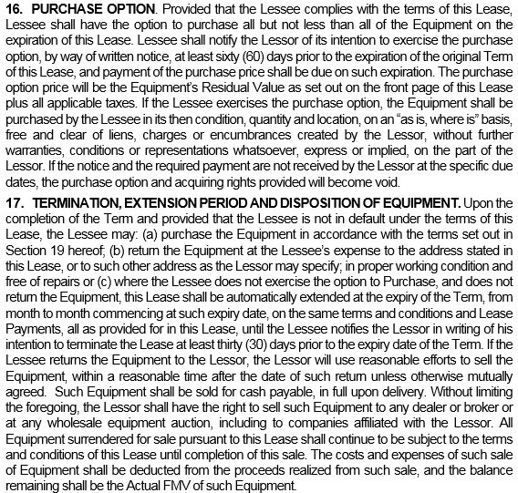
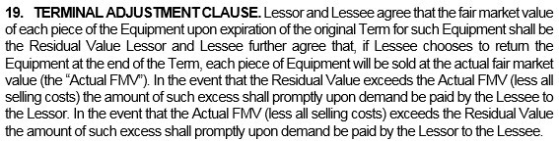

Slide 7
Products – Sales and Security Contract / Agreement
Loan product where dealer and client must sign on agreement (French = CVT)
One dealer per contract (if many – needs to be done under Loan)
GST/PST can be financed up to 3-4 months (need credit approval)
Can have a balloon payment at the last payment (unlike lease, if balloon payment it becomes the last payment ex. loan 59 months + balloon, while lease would be 60 months + residual.)
Plates / registration / titles under client name only
Skips /seasonal payments / IOP available (subject to credit approval)
Rate is disclosed on the agreement in QC, in ROC we only show the total interest charge on the contract.
Accounting / Fiscal treatment = classified as a liability on the balance sheet. Client amortize the asset (depreciation) and interests are expensed.

Slide 8
Products – Loan and security agreement
Loan product, no need to have dealer signature (French = prêt à terme, contrat de prêt et hypothèque)
Usually used for refinancing (repaying client for extra working capital and/or other lenders / dealers or a mix) or when Hazmat is involved
If refinancing we will likely require desktop or physical appraisal from outside firm acceptable to Hitachi (we tend to use S. Guy Gauthier Inc.).
For small refinancing we might be OK with a desktop appraisal (as per credit decision) but physical inspection likely to be required.
Waivers required to get first rank on financed assets for refinancing. If new asset purchased in ROC and registered PPSA within 15 days of delivery we don’t need waiver as our title is valid.
Only product that can be used when we finance an asset related to Hazardous Materials (ex. oil tanker).
Can have a balloon payment at the last payment / taxes balloon
If we do not have copies of all assets original invoices, titles might be used as a proof of ownership (must be under client name only)
Skips /seasonal payments / IOP available (subject to credit approval)

Slide 9
Products – EBR: Definition and Details
Equipment Backed Revolving line (EBR) is a loan product, same characteristics as Loan and Security Agreement in terms of security, but not the way we manage it.
This is like an bank operating line of credit backed by assets (mostly used in construction industry).
Fully flexible, client can repay it all, draw on it, or pay interest only on the used capital.
Physical appraisal required, MHCCA to lend a certain % of asset value
12 months term, with following end of term options:
Renewal for another 12 months (approved amount should be reduced by 20% or client shall provide additional collateral to offset asset depreciation), subject to credit approval.
Amortized over 48 months (rate to be determined at that time, no up front commitment on rate at term out).
Client can repay us entirely
MHCCA cannot walk away after 12 months, worse case it will be termed out on a loan schedule
We can charge a standby fee on unused portion and a monthly fee instead of an up front fee
Not ideal for highway trucks as they depreciate too fast. Could be considered on trailers (ex. tankers).

Slide 10
Products – EBR: Benefits to the client
Clients appreciate the flexibility of this product
Possible to save on interest costs if well managed (ex. used in spring and summer when projects are underway and repay in fall and winter when collecting $, vs paying interest for 12 months in the year)
Bonding company (ex. Intact) appreciate this product as it reduces the risk for them (adds liquidity to the customer)
Complement to bank operating line – sometimes bank will not lend enough on AR (more than 90 days, holdbacks are frequent in construction)
Client only committed for 12 months
On our side, this product is manually managed, more complex and for amounts of $750K and more. We send out an invoice to the client on a monthly basis.
Contribution on EBR is much less than standard term loan due to short term and unused portion

Slide 11
Other products: M.L.A.
MASTER LEASE AGREEMENT (M.L.A.). French: ENTENTE CADRE DE CRÉDIT-BAIL.
Mainly used to improve our security package with a client that would potentially have many active leases with MHCCA
Once M.L.A. is signed, all future contracts (« leasing schedule») are equivalent to be « crossed », which reduces our potential gap in event of reposession of the assets
If a leasing schedule is fully repaid, it no longer falls under the M.L.A. If we want to keep the lien on the asset we would need to get a « booth collateral » on it.
Very easy to document future contracts: leasing schedule stands on 1-2 page
Can be used even if client has contracts with MHCCA
Contracts signed before we put the MLA in place don’t fall under MLA. Hence equity in the assets (if any) should not be considered when analyzing our collateral gap
We might need to provide other lenders with waivers in the future as our registration is similar to a GSA (universality of all present and future assets leased by MHCCA to the customer)

Slide 12
Other products: Booth collateral / CC
CROSS-COLLATERALIZATION (CC)
Means all MHCCA active deals to be crossed on one hypothec
(PPSA / RDPRM additional lien – when a contract is naturally repaid we still hold the lien on the asset)
Without a CC, in the event of bankrupcy, trustee would likely repay us balance
on accounts that are in an equity position, and return the assets that have collateral gap.
CC is more complex to manage than MLA as we need waivers when we register it.
BOOTH COLLATERAL
We add free and clear assets to our deal as additional security, either via accommodation sale or by taking a specific lien on it.
This can replace a down payment, helps have credit approval as it reduces / cancel gap on a new transaction.
Searches and waivers also required when registering a booth collateral.

Slide 13
Other products: Accommodation sale
Accommodation sale: an authorized dealer (ideally A classified dealers) buys the asset from a seller, sells it to MHCCA and we lease it to buyer.
Cannot be done with C dealer.
Rolling stock only
This reduces our risk and makes it easier for us as they should do the searches and waivers, might need to be validated by us depending of the dealer.
Those dealers are also bonded, so we technically have possible recourse against them if something happens down the road.
Usually higher priced transactions and higher fees as less competition and more complex than a standard CAPEX that does not require searches and waivers.
Physical inspection is usually required by credit to confirm that the asset exists.
Higher risk of fraud than a CAPEX with an A dealer, we must be vigilant !

Slide 14
Other products: Sale & Leaseback / Private Sale
SALE & LEASEBACK
Only used in ROC (QC – some restrictions on rolling stock)
Equivalent of a refinancing but done over a lease
Owner of the asset sells to MHCCA who then leases it back to him: this generates liquidity
There might be fiscal cost of doing this as sale to us could create an important capital gain, which would later be offset by new rental expenses on the lease.
PRIVATE SALE
Mostly done in ROC as in QC Accommodation Sale is more frequent
Proof of ownership required / Asset must be free and clear
MHCCA would run searches on the seller of the asset and also on the equipment
Seller sells to MHCCA which leases the asset to the buyer
Should collect higher pricing / fees as more complex and much less competition

